Slide 1
Part01
Link to notebook:
https://colab.research.google.com/drive/1VrNRw3B3v1tbY1f2QgVtDBMjrS73l5lB?usp=sharing

Slide 2
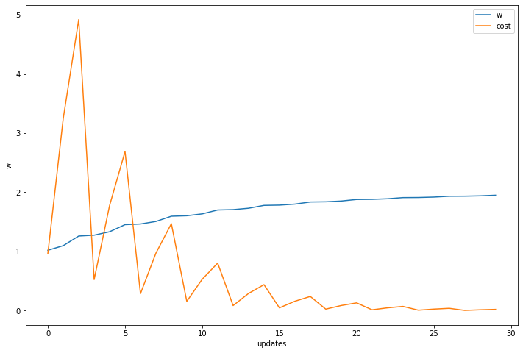
Part01
Define x_data, y_data
Define forward: x * w
Define cost: (y_pred - y)^2
Define gradient: d_cost/d_w: 2*x*(x*w - y)
num_epochs = 10
learning_rate = 0.01
# Learning loop
for epoch in range(num_epochs):
# take each example
for x_val, y_val in (x_data, y_data):
grad = gradient(x_val, y_val)
w = w - learning_rate * grad
l = cost(x_val, y_val)

Slide 3
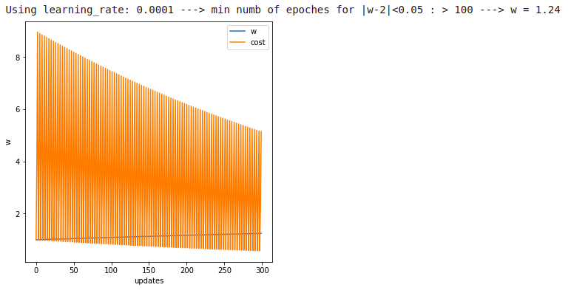
Part01

Slide 4
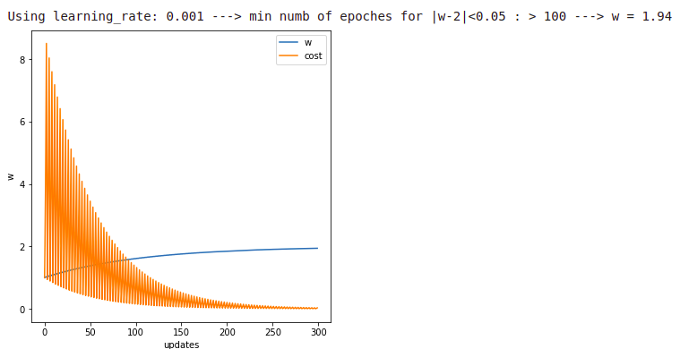
Part01

Slide 5
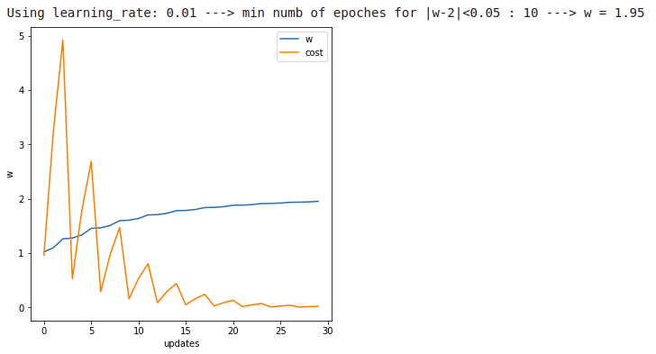
Part01

Slide 6
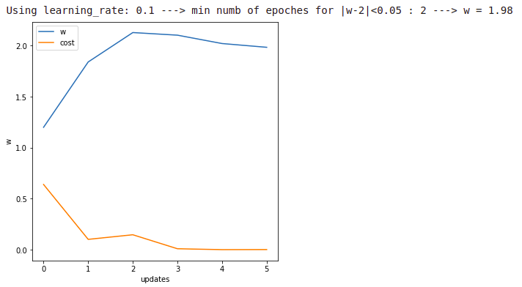
Part01

Slide 7
Part01
Using learning_rate: 0.0001 ---> min numb of epoches for |w-2|<0.05 : > 100 ---> w = 1.24
Using learning_rate: 0.001 ---> min numb of epoches for |w-2|<0.05 : > 100 ---> w = 1.94
Using learning_rate: 0.01 ---> min numb of epoches for |w-2|<0.05 : 10 ---> w = 1.95
Using learning_rate: 0.1 ---> min numb of epoches for |w-2|<0.05 : 2 ---> w = 1.98
Using learning_rate: 1.01 ---> min numb of epoches for |w-2|<0.05 : > 100 ---> w = -2.3209131793824674e+209
Using learning_rate: 1.08 ---> min numb of epoches for |w-2|<0.05 : > 100 ---> w = -2.1440082493182813e+221
Using learning_rate: 2.0 ---> min numb of epoches for |w-2|<0.05 : 97 ---> w = nan

Slide 8
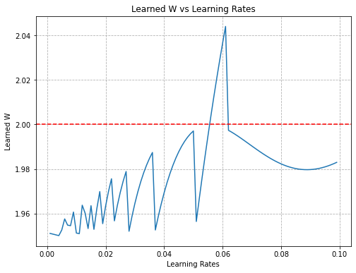
Part01

Slide 9
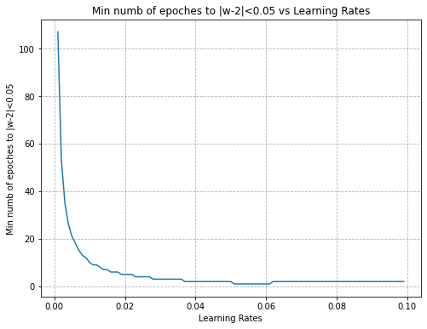
Part01

Slide 10
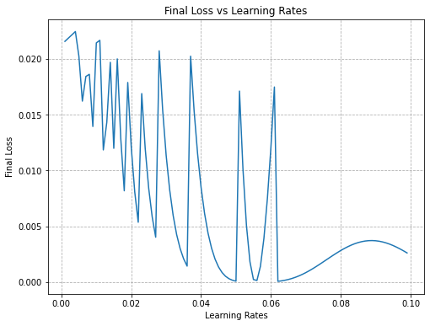
Part01

Slide 11
Part02
Link to notebook:
https://colab.research.google.com/drive/1iG_nFHOOzXOSfbA0obrqRQR5vGTFCE3y?usp=sharing

Slide 12
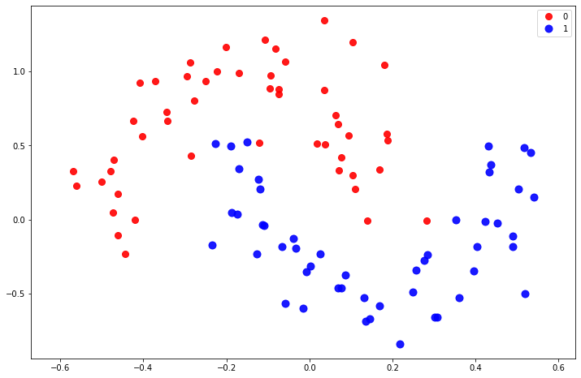
Part02

Slide 13
Part02
Linear
Define model using nn.Module
# The criteria to optmize (cost)
criterion = nn.CrossEntropyLoss()
# The optimization algorithm
optimizer = torch.optim.SGD(model.parameters(), lr=0.01, momentum=0.9)
batch_size = 100
num_epochs = 50
Neural Net

Slide 14
Part02
# Learning loop
for epoch in range(num_epochs):
# take each example
for beg_i in range(0, x_data.size(0), batch_size):
X_batch = …
Y_batch = ...
# reset gradients to zero:
optimizer.zero_grad()
# forward:
outputs = model(x_batch)
loss = criterion(outputs, y_batch)
# backpropagation
loss.backward()
optimizer.step()

Slide 15
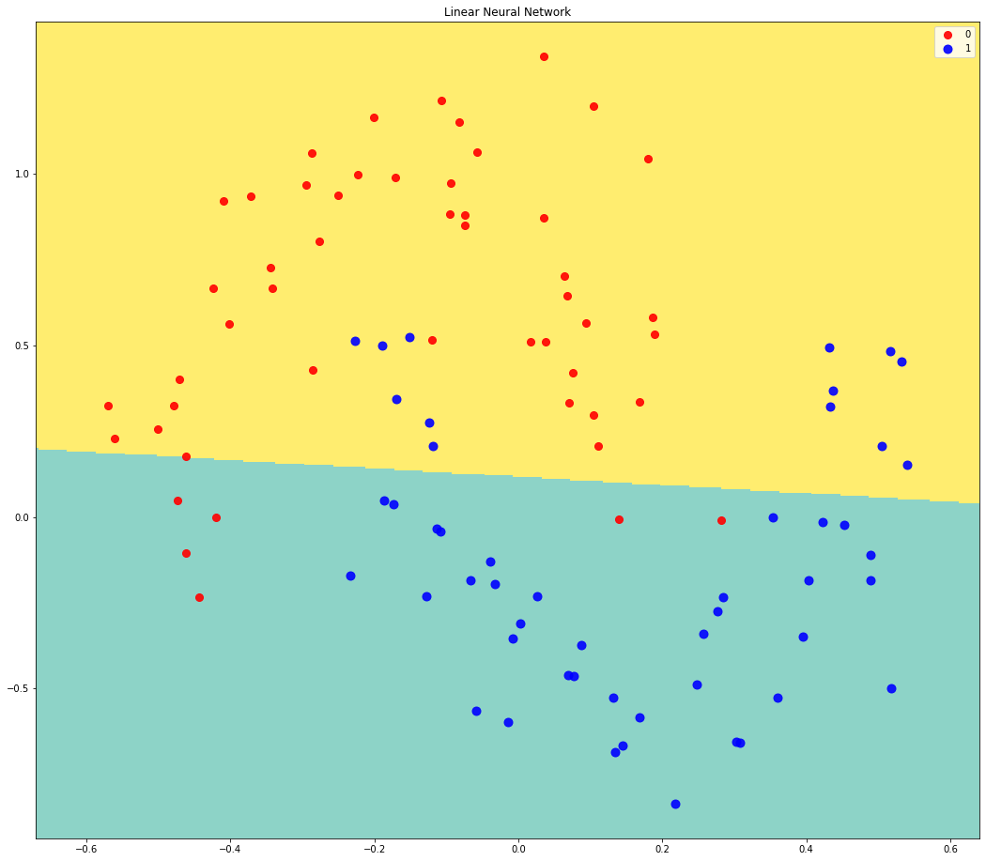
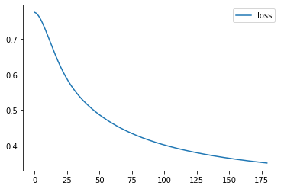

Part02
Using Linear Model
error rate (%): 19.0

Slide 16
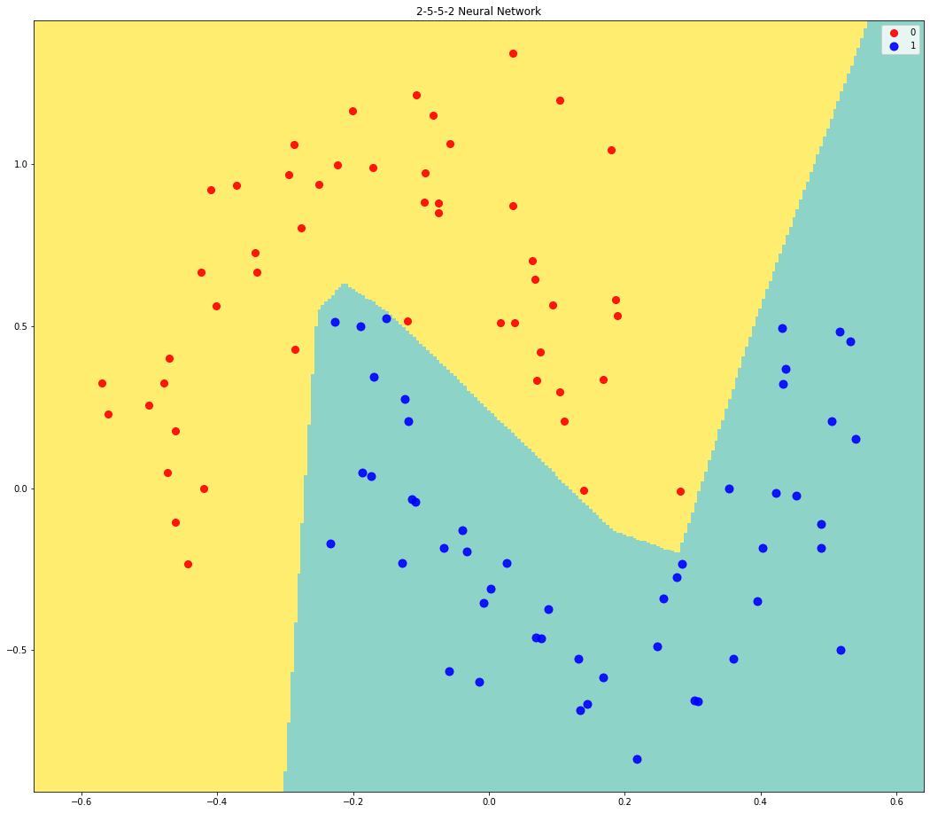
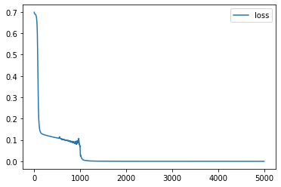

Part02
Using NN Model
error rate (%): 0.0

Slide 17
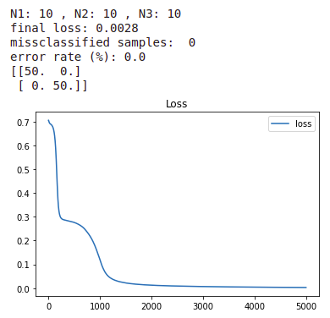
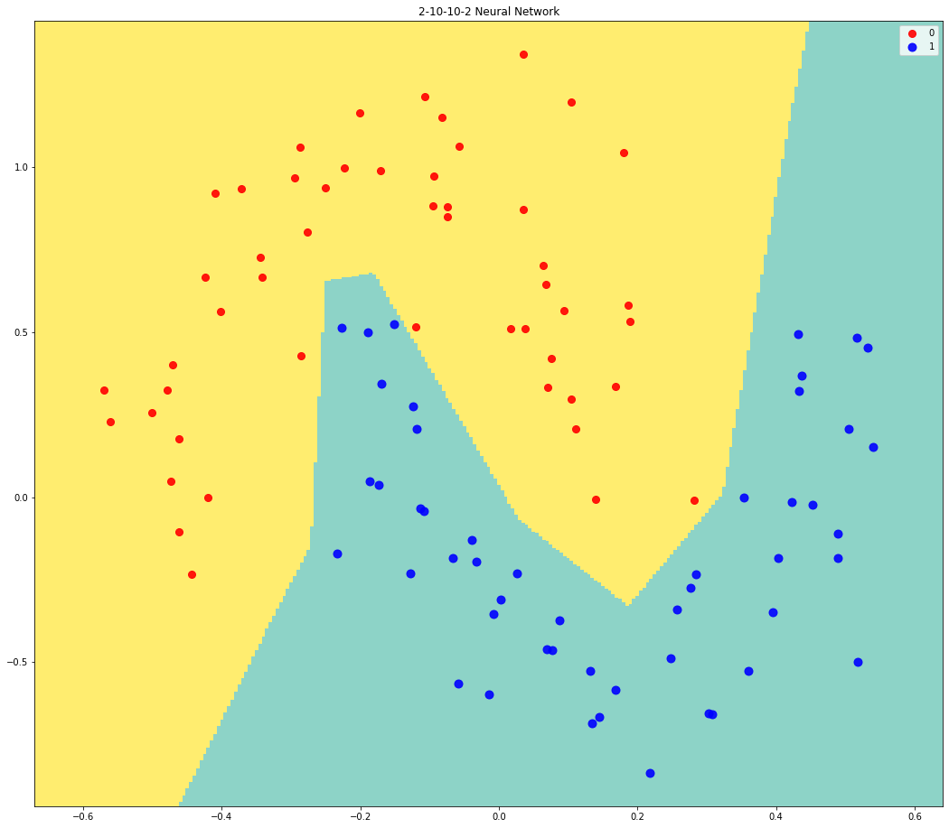
Part02
Using NN Model
BEST MODEL

Slide 18
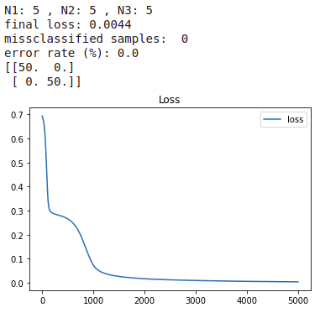
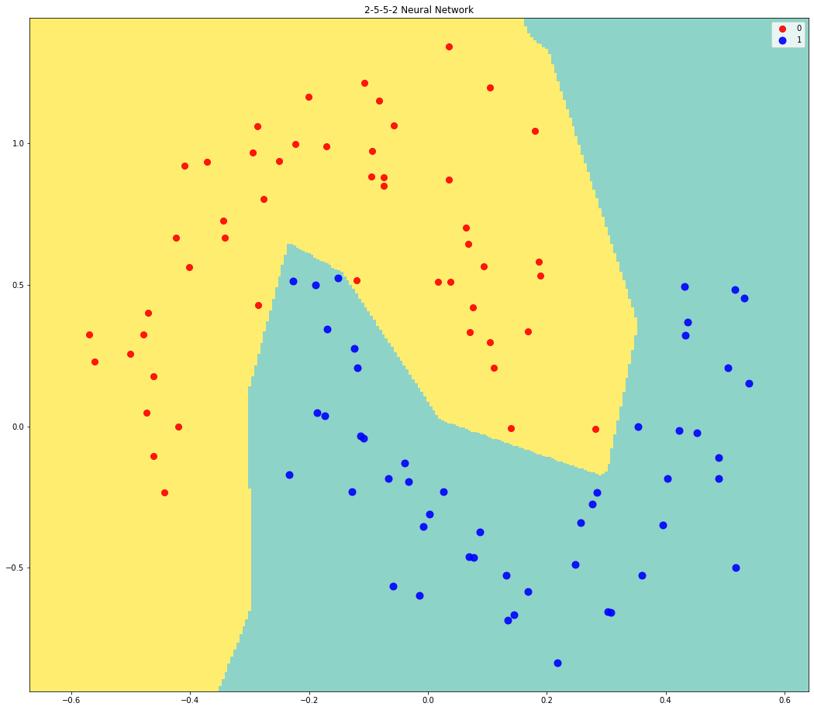
Part02
Using NN Model
2ND BEST MODEL

Slide 19
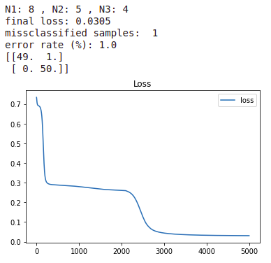
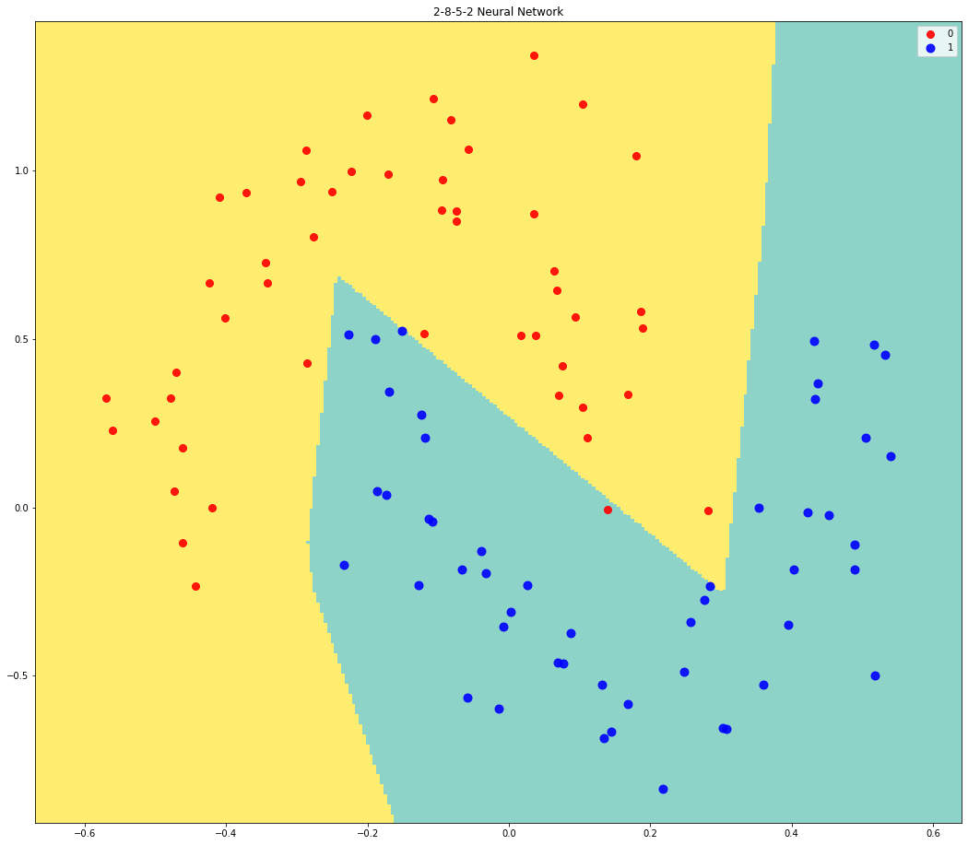
Part02
Using NN Model

Slide 20
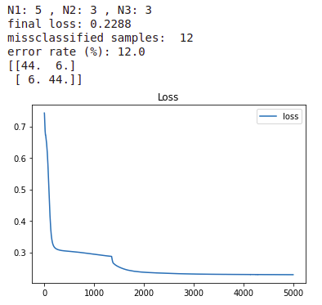
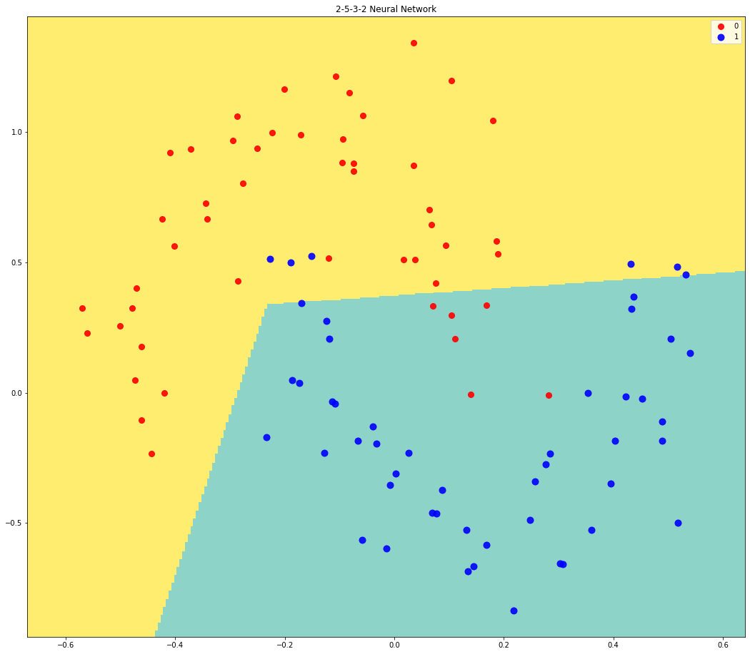
Part02
Using NN Model

Slide 21
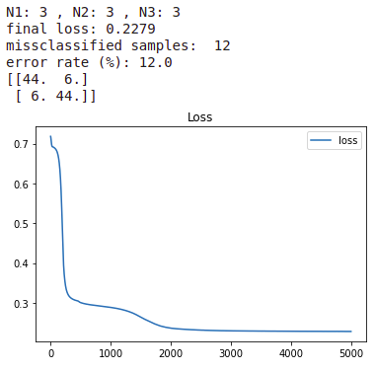

Part02
Using NN Model

Slide 22
Part03
Link to notebook:
https://colab.research.google.com/drive/1fHNqehBM2g0-0u7Q7mpBQ1051DEGyXS8?usp=sharing

Slide 23
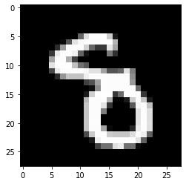
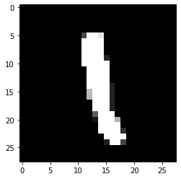
Part03

Slide 24
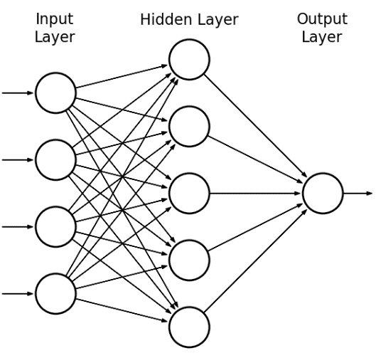
Part03

Slide 25
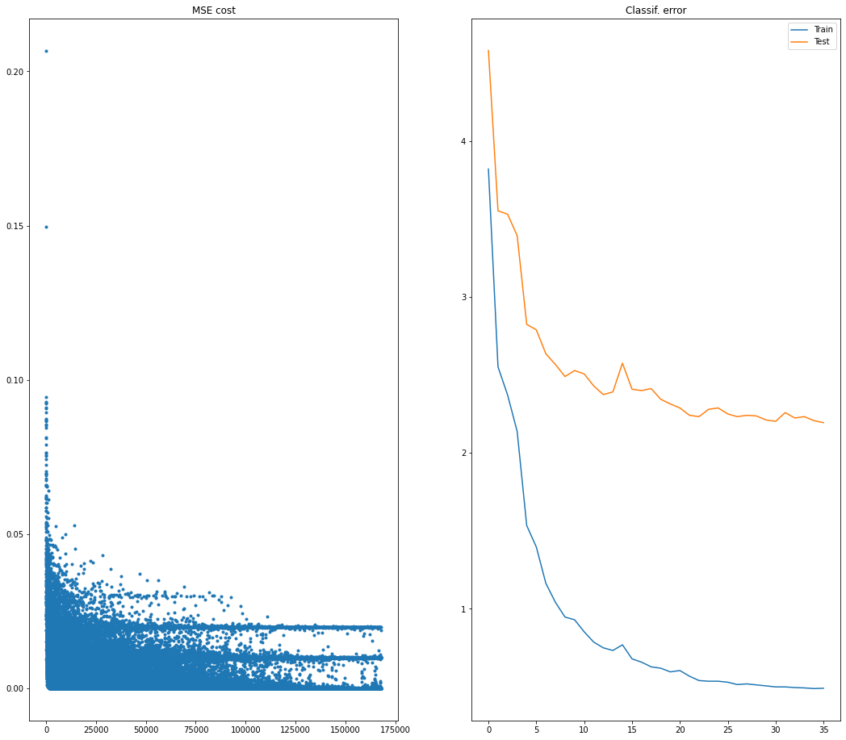
Part03
N1 = 100

Slide 26
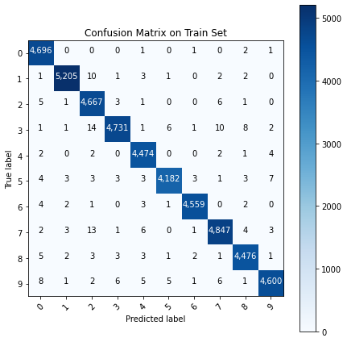
Part03
N1 = 100

Slide 27
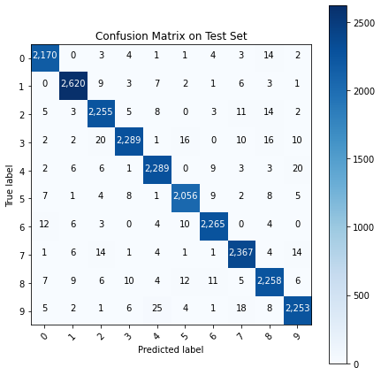
Code03
N1 = 100

Slide 28
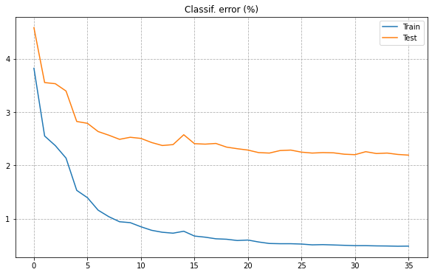
Code03
N1 = 100

Slide 29
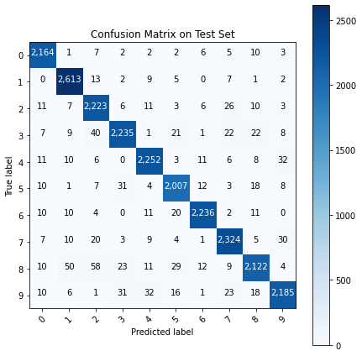
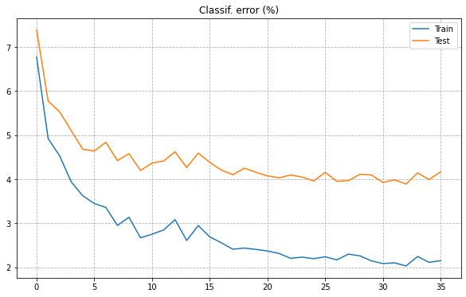
Part03
Error in Train Set: 2.15 %
Error in Test Set: 4.17 %
N1 = 30

Slide 30
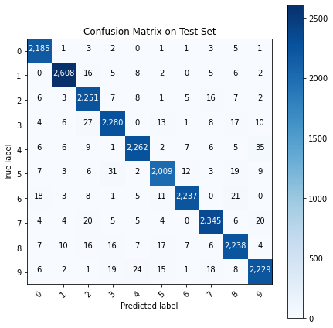
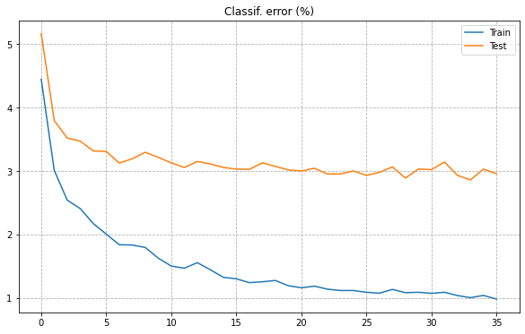
Part03
Error in Train Set: 0.98 %
Error in Test Set: 2.96 %
N1 = 50

Slide 31
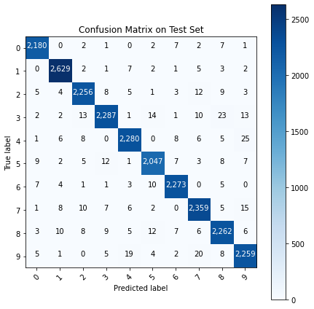
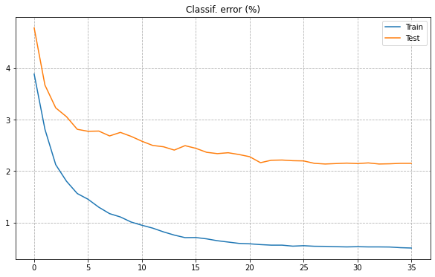
Part03
Error in Train Set: 0.51 %
Error in Test Set: 2.15 %
N1 = 100

Slide 32

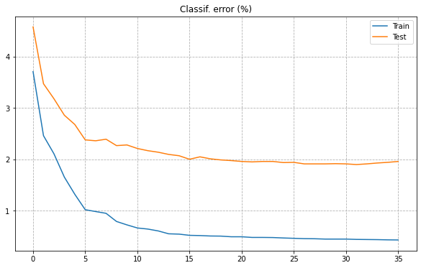
Part03
Error in Train Set: 0.43 %
Error in Test Set: 1.96 %
N1 = 150

Slide 33

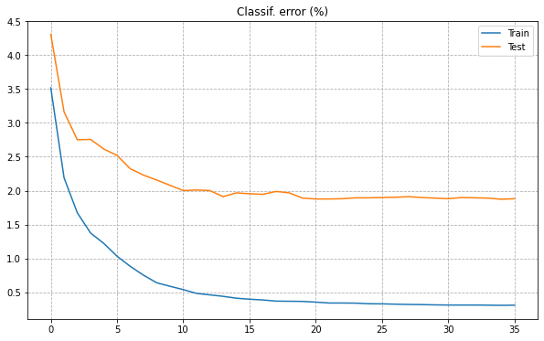
Part03
Error in Train Set: 0.31 %
Error in Test Set: 1.88 %
N1 = 200

Slide 34

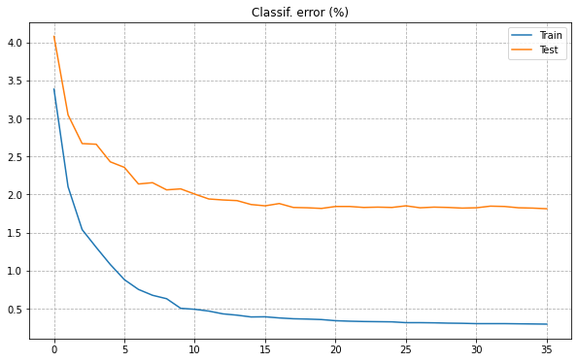
Part03
Error in Train Set: 0.3 %
Error in Test Set: 1.81 %
N1 = 250

Slide 35

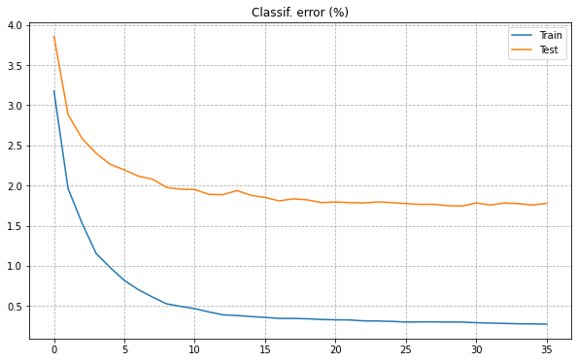
Part03
Error in Train Set: 0.27 %
Error in Test Set: 1.78 %
N1 = 300

Slide 36
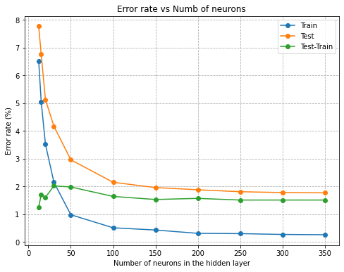
Part03

Slide 37
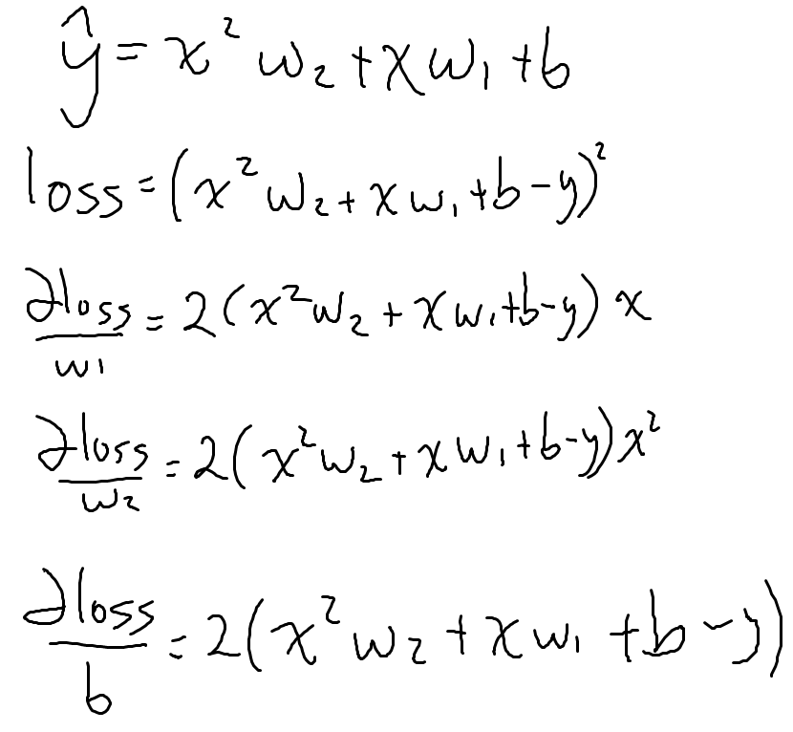
Part04: Exercise (not a neural network)
Link to notebook:
https://colab.research.google.com/drive/1dhSr-d21Hf2W8RE2hQcG5FrQ7DGv55Jk?usp=sharing

Slide 38
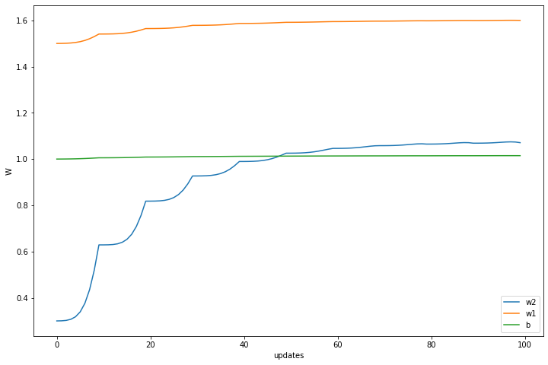
Part04: Exercise (not a neural network)

Slide 39
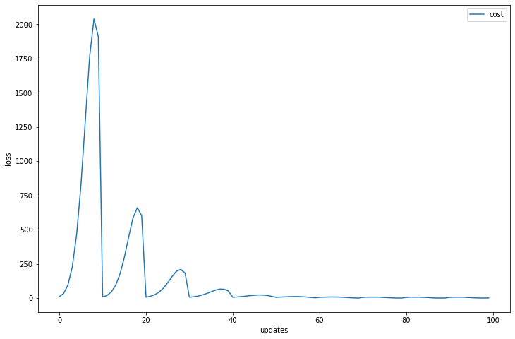
Part04: Exercise (not a neural network)

